Slide 1
Deep weeds via deep fake
Deep Learning for Computer Vision, EN 525.733
April 27th, 2022
Mohammed Rashed Whiting School of Engineering, Johns Hopkins University | Gerald McCollam Whiting School of Engineering, Johns Hopkins University

Slide 2
Introduction
Related Works
Proposed Approach
Methodology
Experimental Details
Results and Analysis
Conclusion
Introduction
Problem: training a DNN model (deep weeds) to classify weeds requires extensive data collection to achieve optimal performance
Value: data augmentation with synthetic data could be an efficient way to train a weed classifier.
Finding:
Synthetic data achievable with DCGAN and ACGAN
Model X does best in deepweeds classification

Slide 3
Introduction
Related Works
Proposed Approach
Methodology
Experimental Details
Results and Analysis
Conclusion
Related Work

Slide 4
Introduction
Related Works
Proposed Approach
Methodology
Experimental Details
Results and Analysis
Conclusion
Proposed Approach
Survey GAN models for deepweeds - DC GAN and AC GAN
Augment training data with synthetic data
Fine-tune RseNet50
Compare with Inception model

Slide 5
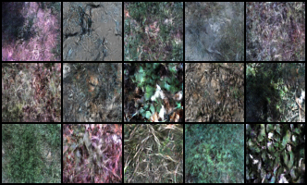
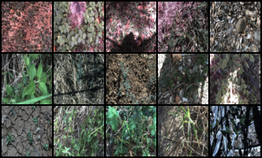
Methodology (Experiment 1)
Introduction
Related Works
Proposed Approach
Methodology
Experimental Details
Results and Analysis
Conclusion
We generated our first sample of synthetic images of weeds by training a DCGAN model on our entire dataset (17044 images). The model generates visually high-quality images however limited to 64x64 resolutions and it does not generate labels for the images. The generator hence requires training on individual classes (smaller sample, approx. 1:2 ratio) and augmenting each class 10 folds.
Fig: Synthetic Images
Fig: Real Images
Attributes | Values
Deconv. layers | 100 ->{4x4x1024, 8x8x512, 16x16x256, 32x32x128, 64x64x64} -> 64x64x3
Conv layers | 64x64x3 ->{64x64x64, 32x32x128, 16x16x256, 4x4x1024, 8x8x512} -> 0,1
Input/Output dim. | 64x64
 | Accuracy
TBD | None
TBD | None
TBD | TBD
Fig: Test Results
Fig: Architecture Metadata for DC GAN

Slide 6
Introduction
Related Works
Proposed Approach
Methodology
Experimental Details
Results and Analysis
Conclusion
Methodology: GAN Journey
ACGAN with data augmentation.

Slide 8
Questions

